Slide 1
High order functions computations in c++ 14
Radu Postelnicu

Slide 2
Functional programming
What?
Why?
When?
How?

Slide 3
What?
Programming paradigm based on lambda calculus (Alonzo Church – 1930s)
Formal system in mathematical logic for expressing computations using algebra of functions
Operations:
Function definition (function currying, function composition)
Function application (variable binding and substitution)

Slide 4

Why?
Program in execution as a dynamical system with states
$\left\{\begin{aligned}x ̇=X(x, u) \\ y=Y(x, u) \end{aligned}\right.⇒sequence of instructions$
Functional programming’s proposal:
Functional unit
Side effect unit
input
Functional unit 1
Functional unit 2
…
Functional unit n
output

Slide 5



When?
“All problems in computer science can be solved by another level of indirection” David J. Wheeler
Scalability $→$ compose abstract units $→$ build and work with abstractions $→$ change representation
Ex: Surface of the yellow square
8.00000000002…
$$S={\sqrt{2^{2}+2^{2}}}^{2}=8$$
$$\sqrt{8}=2.828…$$
2
2

Slide 6
How?
Most basic form of computation is expressed in numbers
A natural number N is expressed as N applications of (+1) over 0
If we note (+1) with f and 0 with x we have:
(define (zero f) (lambda (x) x))
(define (one f) (lambda (x) (f x)))
auto zero = [] (auto f) {
return [] (auto x){
return x;
};
};
auto one = [] (auto f) {
return [f] (auto x){
return f(x);
};
};
auto two = [] (auto f) {
return [f] (auto x){
return f(f(x));
};
};

Slide 7
Basic mathematical operations
What can we do with numbers:
Increment, decrement, add, subtract, multiply …
auto increment = [](auto fn) {
return [fn] (auto f) {
return [fn, f] (auto x) {
return f(fn(f)(x));
};
};
};
auto add = [] (auto fn1) {
return [fn1] (auto fn2) {
return fn2(increment)(fn1);
};
};
auto mul = [] (auto fn1) {
return [fn1] (auto fn2) {
return [fn1, fn2] (auto f) {
return fn1(fn2(f));
};
};
};

Slide 8
Basic mathematical operations
Decrement – the idea is to find a way to omit the first application of f
auto decrement = [] (auto fn) {
return [fn] (auto f) {
return [fn, f] (auto x) {
return fn([f] (auto g) {
return [f, g] (auto h) {
return h(g(f));
};
}) ([x] (auto u) {return x;}) ([] (auto x) {return x;});
};
};
};
decrement two f x =
two (\g h -> h $ g f) (\_ -> x) id =
(\g h -> h $ g f) . (\g h -> h $ g f) (\_ -> x) id =
(\g h -> h $ g f) (\h -> h $ (\_ -> x) f) id =
(\h -> h $ (\i -> i $ (\_ -> x) f) f) id =
id $ (\i -> i $ (\_ -> x) f) f =
(\i -> i $ (\_ -> x) f) f =
f $ (\_ -> x) f =
f x =
one

Slide 9
Basic mathematical operations
Subtract
auto sub = [] (auto fn1) {
return [fn1] (auto fn2) {
return fn2(decrement)(fn1);
};
};

Slide 10
Booleans
Even conditional expressions can be modeled using functions
auto truef = [] (auto x) {
return [x] (auto y) {
return x;
};
};
auto falsef = [] (auto x) {
return [] (auto y) {
return y;
};
};
auto ifte = [] (auto boolean) {
return [boolean] (auto t) {
return [boolean, t] (auto f) {
return boolean(t)(f);
};
};
};
auto isZero = [] (auto fn) {
return fn([] (auto u) {
return falsef;
})(truef);
};

Slide 11
Computations
Before we do any computation we need a way to visualize the result
auto toNumRepr = [] (auto fn) {
return fn([] (auto x) {
return x+1;
})(0);
};

Slide 12
Computations
Can we do a random computation?
How about a factorial? Actually we can’t do it because c++ still has only strict evaluation
auto random_computation = [] (auto fn) {
return ifte(isZero(fn))
(add(increment(fn))(three))
(mul(decrement(fn))(three));
};
toNumRepr(random_computation(zero)) // = 4
toNumRepr(random_computation(two)) // = 3
auto fact = [] (auto fn) {
return ifte(isZero(fn))
(one)
(mul(fn)(fact(decrement(fn))));
};

Slide 13
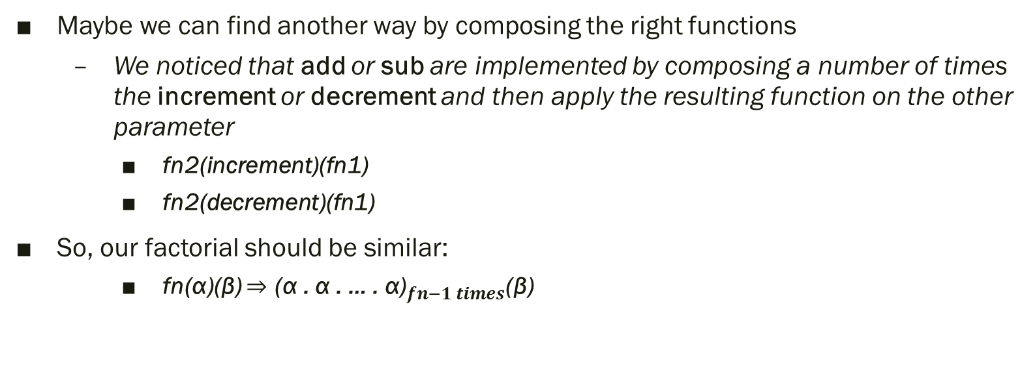
Computations
Maybe we can find another way by composing the right functions
We noticed that add or sub are implemented by composing a number of times the increment or decrement and then apply the resulting function on the other parameter
fn2(increment)(fn1)
fn2(decrement)(fn1)
So, our factorial should be similar:
fn(α)(β) $⇒$ ${\text{(}\text{α} \text{. }\text{α}\text{ . }\text{… }\text{. }\text{α}\text{)}}_{fn−1 times}$(β)

Slide 14
Computations
In other words α should compose the multiplications with incremental values
should have 2 input parameters and 2 output parameters
1 input tuple and 1 output tuple
This means β will be pair(mul(one))(one)
auto pair = [] (auto x) {
return [x] (auto y) {
return [x,y] (auto z){
return z(x)(y);
};
};
};
auto first = [] (auto p) {
return p([] (auto x) {
return [x] (auto y) {
return x;
};
});
};
auto second = [] (auto p) {
return p([] (auto x){
return [] (auto y){
return y;
};
});
};

Slide 15
Computations
Now our factorial will look like
Where for example three(α)(β) = pair((mul(mul(mul(one)(two))(three))), three)
Because the resulting composed function applied to the initial tuple returns a tuple we extract the first member (which is the multiplication composition) and apply it to one
auto fact = [] (auto fn) {
return first(decrement(fn)([] (auto p) {
return pair(mul(first(p)(increment(second(p)))))(increment(second(p)));
})(pair(mul(one))(one)))(one);
};

Slide 16
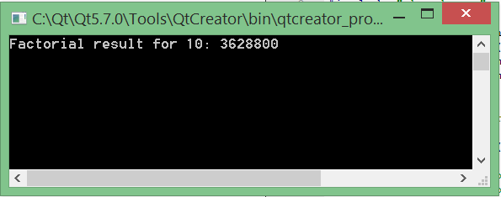
Computations
Now lets put it to a test
auto ten = [] (auto f) {
return [f] (auto x) {
return f(f(f(f(f(f(f(f(f(f(x))))))))));
};
}; std::cout<<"Factorial result for 10: "<<toNumRepr(fact(ten))<<std::endl;

Slide 17
Conclusions
Basically, we can achieve complete computability using only functions.
This is how functional programming started
Untyped/typed lamda calculus + numeric, boolean native support = most of functional programming today

Slide 18
Q&A

Slide 19
Thank you for your attention

